Slide 1
Foundation of Informatics Project3 presentation
Group members : Zijun(ZED), Tianyi (Oliver)

Slide 2
Today’s presentation outlines
1st section : dataset selections;
data management ;
problems, hypotheses; insights.
2nd section : code management;
structure of web application
3rd section : Last part: Q&A(3 mins)

Slide 3
Part 1: dataset selections; Data management; problems hypotheses; insights

Slide 4
Dataset - Building information 2015 from:https://data.melbourne.vic.gov.au/Property-Planning/Building-information-2015/2r42-d7pj
Reason:
close to our life;
Easy to understand;
Have enough elements;
Csv file;
Out of time…..

Slide 5
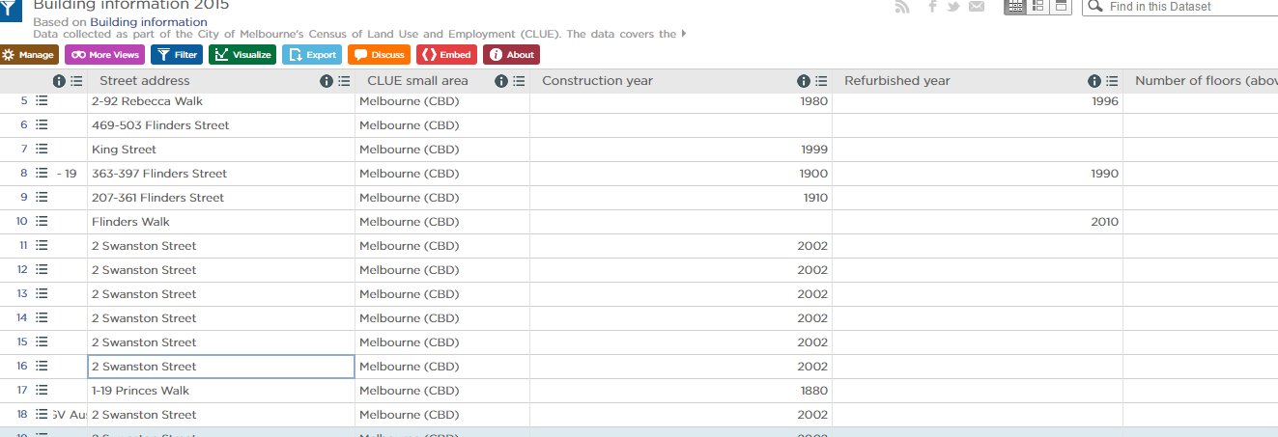
Briefly introduce the dataset
Block ID
Property ID
Base property ID
Building name
Streetaddress
CLUE small area
Construction year
Refurbished year
Number of floors (above ground)
Predominant space use
Accessibility type
Accessibility type description
Accessibility rating
Bicycle spaces
Has showers

Slide 6
Briefly introduce the dataset
Block ID
Property ID
Base property ID
Building name
Streetaddress
CLUE small area
Construction year
Refurbished year
Number of floors (above ground)
Predominant space use
Accessibility type
Accessibility type description
Accessibility rating
Bicycle spaces
Has showers
Where ?
When ?
What’s type ?
Quaility ?

Slide 7
Data management
Observe dataset
Step1 : analyse
Step2 : good or bad blank cell?
By using countif (<5 , bad ,good )
Have a discussion
Step3 : fill those good blank cells
By using if(G2 = 0, 0, G2)
Step4 : delete those bad blank cells
Select region
Button F5
Select blank
Ctrl + ‘-’
Delete rows
major problem
Blank cells
minor problem
Useless column
Manually delete them

Slide 8
Observation
problems, hypotheses; insights.

Slide 9
Part 2: Code management structure of web application

Slide 10
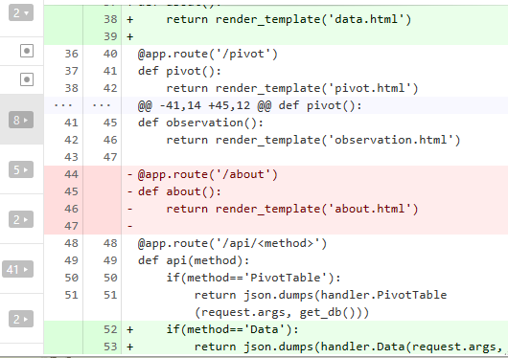
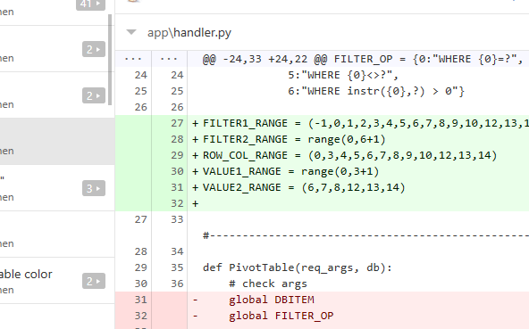

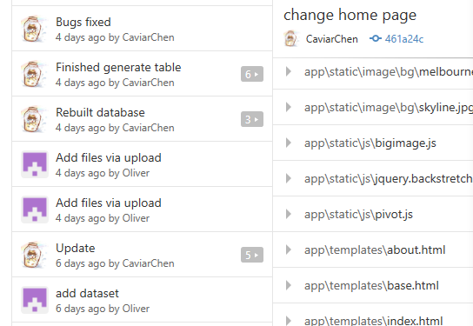
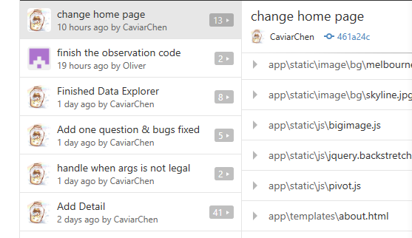
Code management

Slide 11
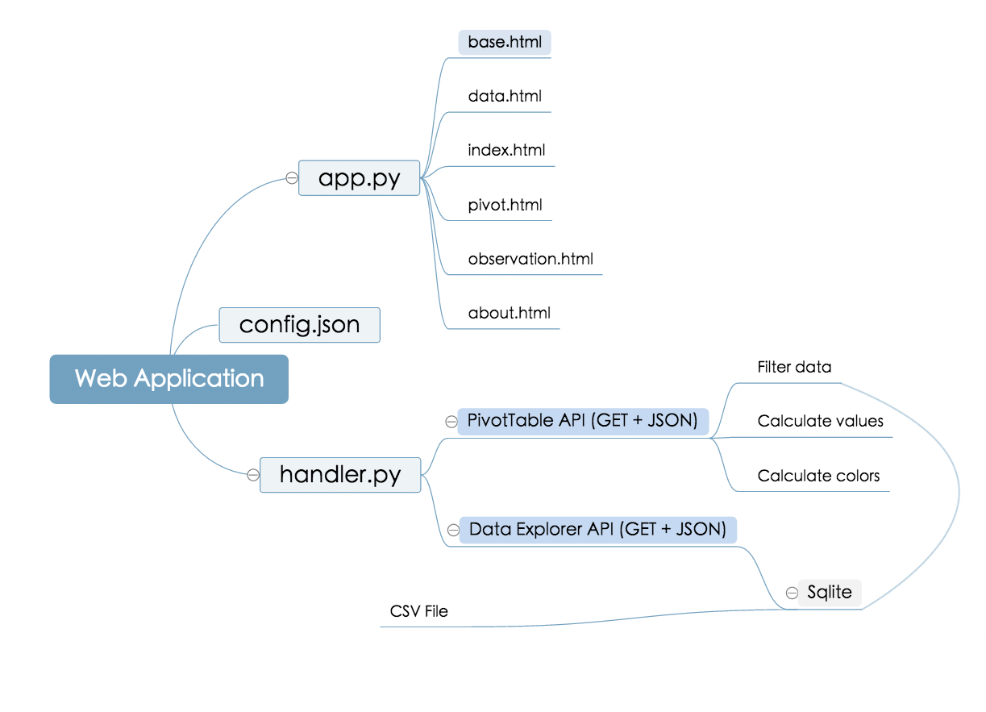
structure of web application

Slide 12
Q&A time

Slide 13
Thank you all
Group members : Zijun(ZED), Tianyi (Oliver)

